Slide 1

https://www.uni-goettingen.de/en/48115.html
UNPLAB-QuGen_Ch-12[QG Lines II]
Continuation of Quantitative Genetics for Line Breeding
1

Slide 2
Sequential Number: #46
UNPLAB-QuGen_Ch-11[QG Lines II]
Unless I explicitly state otherwise, images and cartoons are created using ChatGPT.
You may use this material free of charge under the terms of the CC BY license. This requires that you provide appropriate attribution to the author:
W. Link, University of Goettingen, Germany.
In a few cases, individual images, photographs, or similar material may be subject to a more restrictive Creative Commons license. Where this applies, it is explicitly indicated, and you must comply with the stated license terms for those items.
Please check the license information carefully before reuse. Responsibility for complying with the applicable license terms rests entirely with you.
2

Slide 3
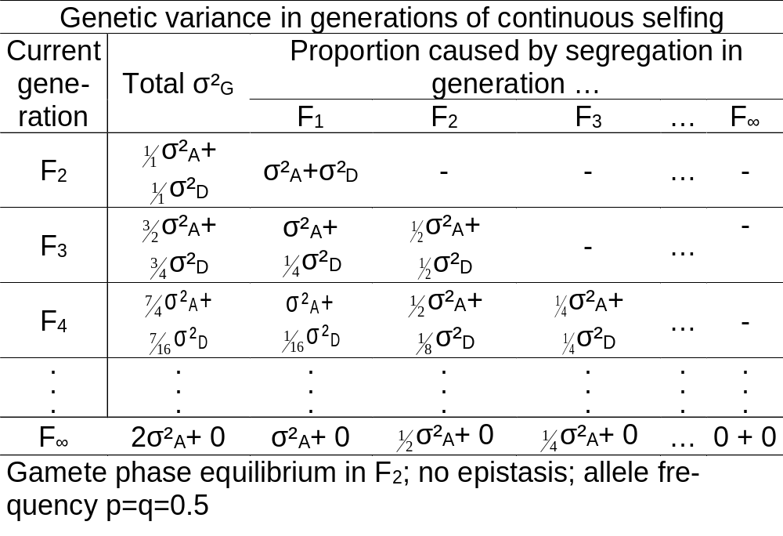
You already know:
Population Genetics (HWE, Inbreeding, Drift, Selection, Equilibrium of Selection and Mutation, Equilibrium of Selection and Drift, Gamete Phase Disequilibrium; the decomposition of the Phenotypic Variance, GxE inlcuding Stability and Breeder‘s Equation; Breeding Methods incl. Heterosis, GCA, Recurrent Selection Schemes, and the Four Categories of Plant Breeding with their Methods; Correlated Traits and Index Selection; The parameters of the Metric Model and of the Statistical Model, the decomposition of the Genetic Variance; Segregation within a single Mendelian cross in Generations F2, F3.
Keywords of this chapter: Genetic
segregation in the inbred progenies
of a Mendelian Cross, such as F2,
F3 and beyond.
Algebra as introduced in this chapter:
3

Slide 4
You already took home:
Multi-locus segregation causes new genotypic diversity in each selfing genera-tion. The size of fresh segregation variance decreases proportionally to the meanwhile decreased degree of heterozygosity => the additional increment in variance can be neglected as early as (about) F₆ generation.
The additive share of the genetic variance in the basic generation F₂ is con-served (in case of no selection) across selfing generations. The already released part of the additive variance and the (in every generation newly) created additive variance accumulate. In later generations of selfing, the breeder disposes, hence, on a markedly greater additive variance than in the early generations of selfing.
That part of the genetic variance that is caused by dominance effects decreases from generation to generation. Already at about F₄ we can usually neglect dominance as cause of genetic variance.
4

Slide 5
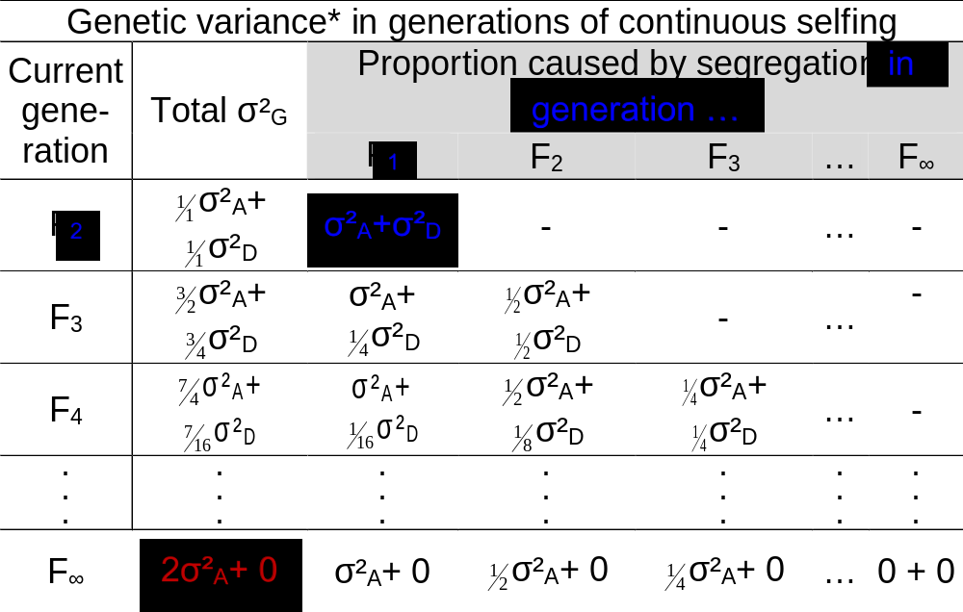
See the F3-lines as derived from selfing their ancestral F2-individual, see the F4-lines as derived from ancestral F3-individuals and one F4-family tracing back to one F2-plant.
Pedigree
X
P
Total σ²_{G}
F₁
…
…
…
…
…
…
…
5

Slide 6
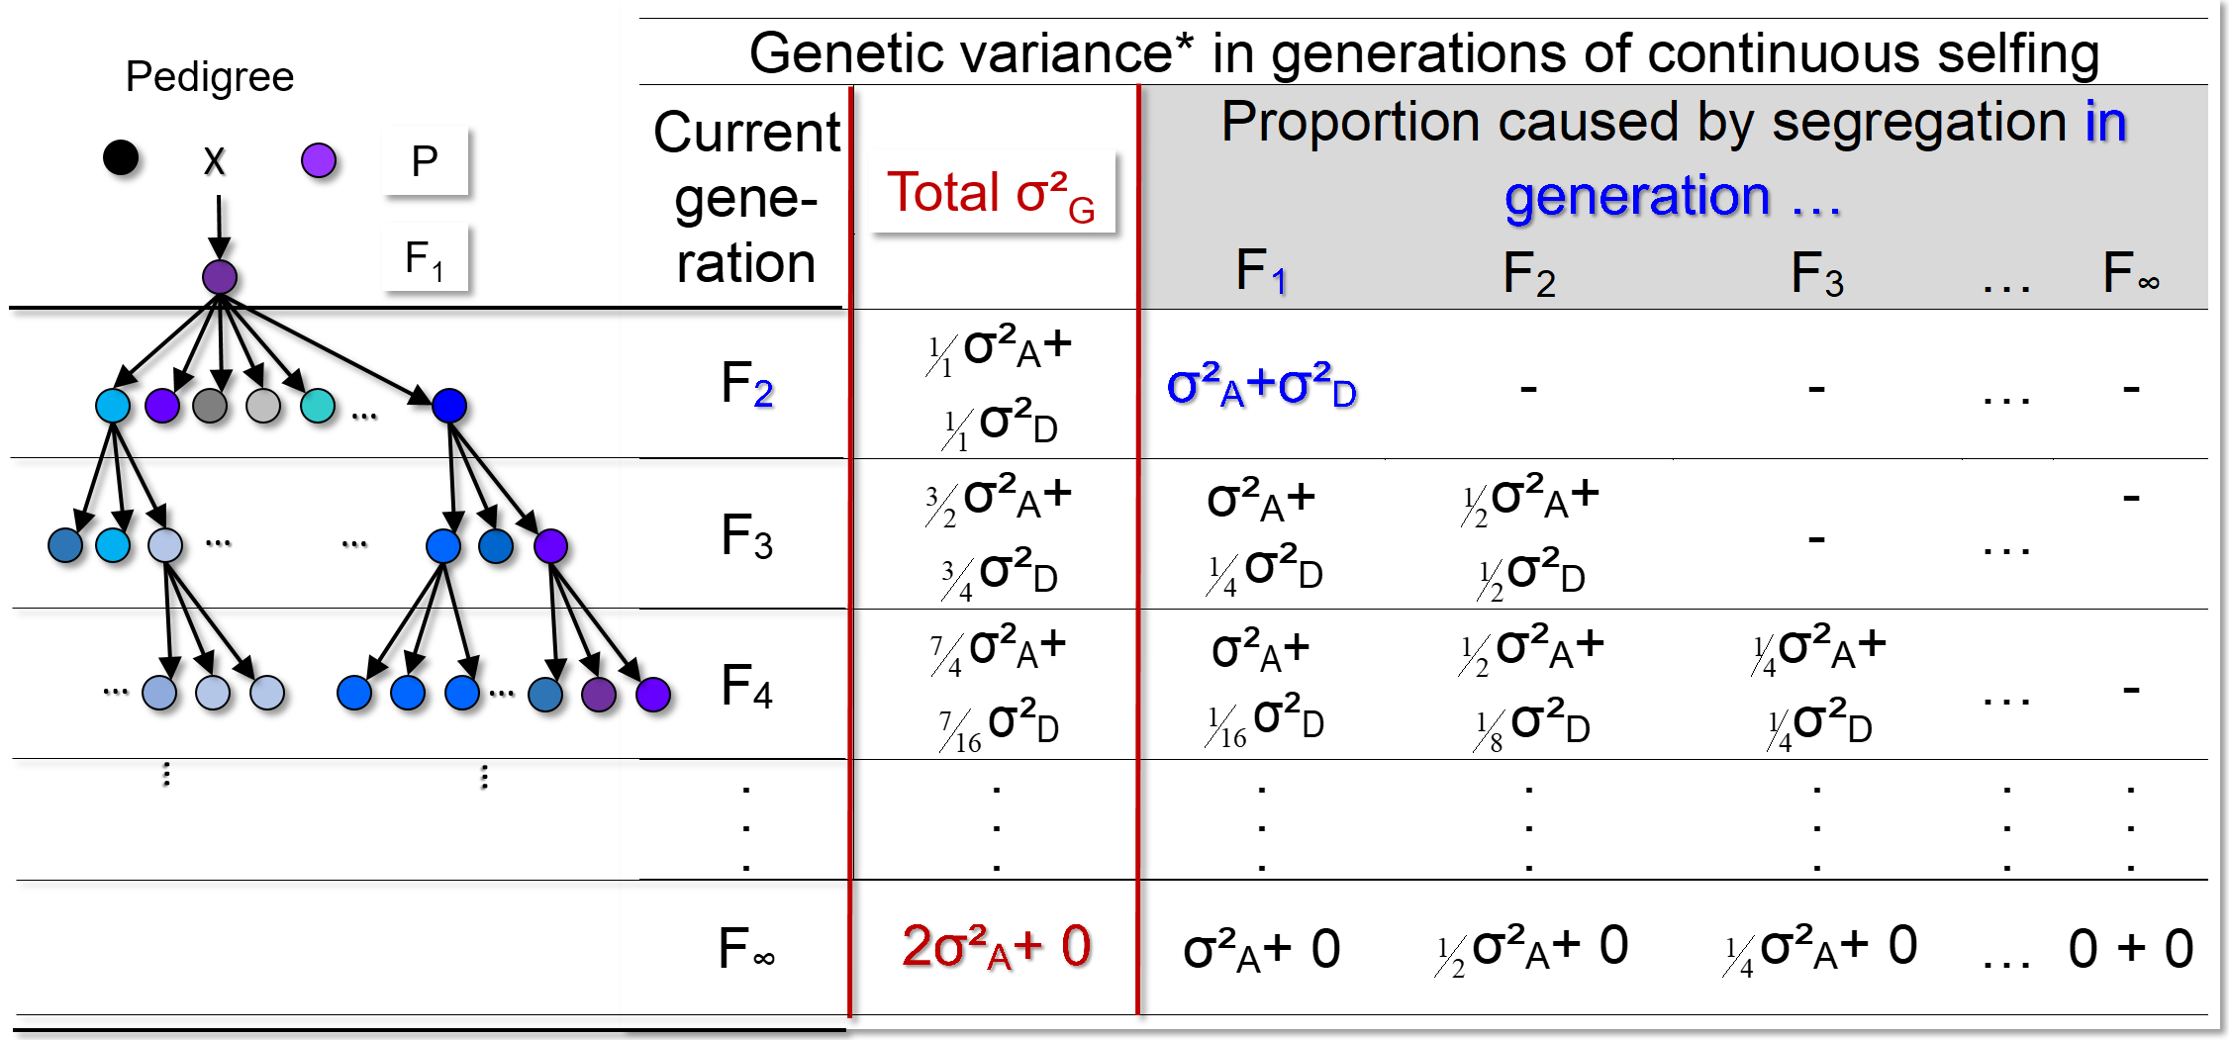
See the genetic variance between F2-individuals, it was created by meiosis in F1
6

Slide 7
See the genetic variance between F3-lines, it was created by meiosis in F1
7

Slide 8
Genetic variance between F3-plants within F3-lines, created by F2-meiosis
8

Slide 9
The total genetic variance in F3: ‚Between F3-lines‘ plus ‚Within F3-lines‘.
9

Slide 10
Genetic variance between F4-families (aka F2-derived partial bulks in generation F4), it was created by meiosis in F1.
10

Slide 11
Genetic variance between all F4-lines (each line came from ist ‚private‘ F3-plant (variance caused by F1-meiosis plus from F2-meiosis)
…
11

Slide 12
Shall we realy wait for the small, little segregation variance ‚inside‘ of F4-lines?
…
12

Slide 13
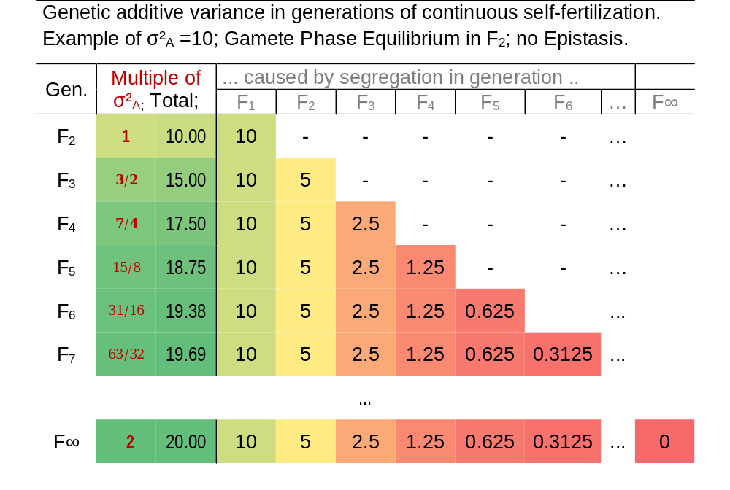
Of course, there are not only 6 F2-individuals but very many, and not only three individuals in the later lines but many. And there is not only one trait (colour) but several.
Note the very regular ‚behaviour‘ of the additive variance (dominance variance neglected here)
Pedigree
X
P
F₁
…
…
…
…
…
…
…
…
…
…
…
…
…
13

Slide 14
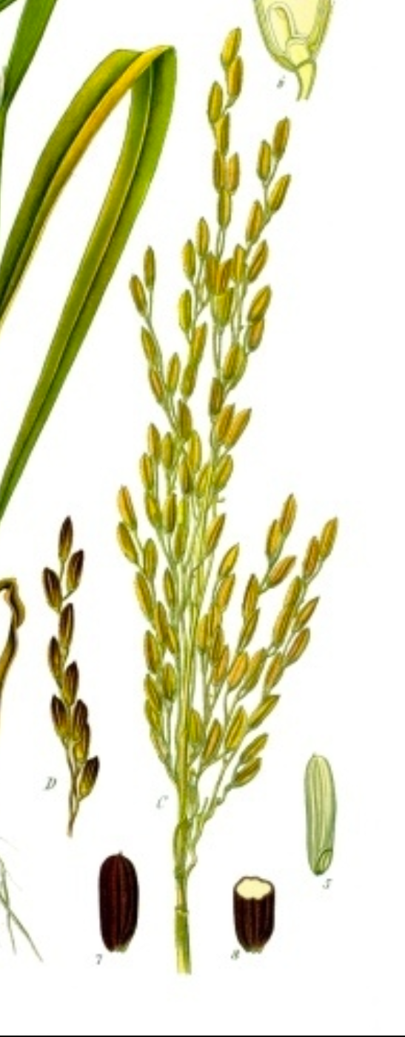
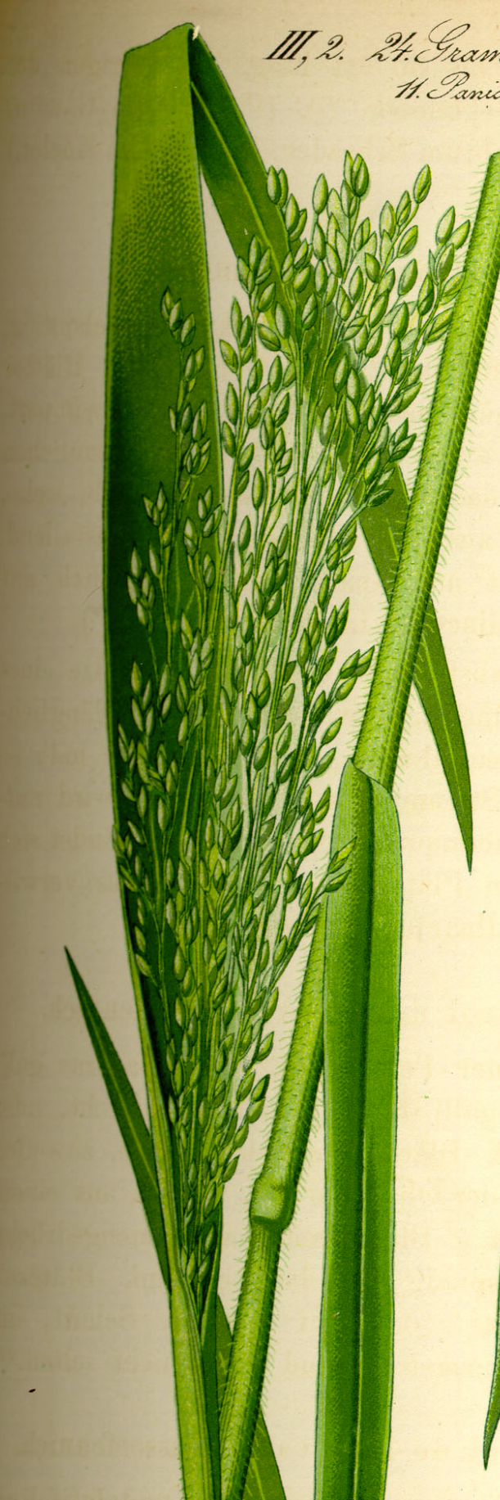
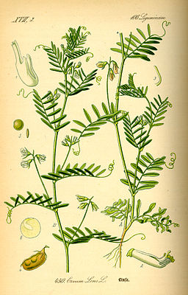
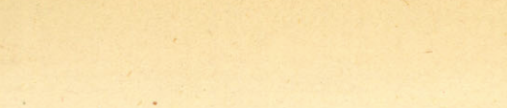
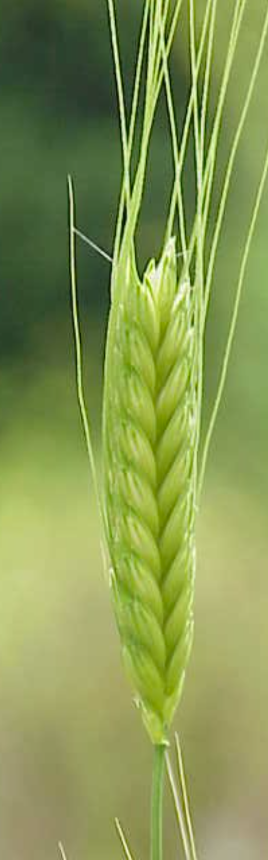
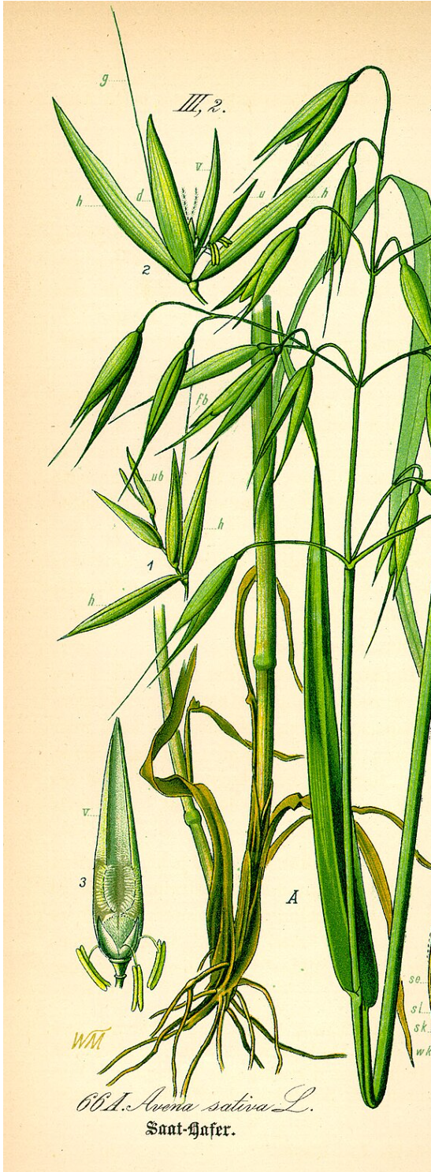
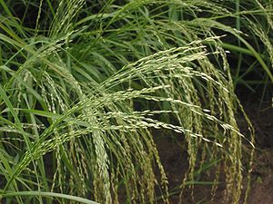
Some crops for Line Breeding: Wheat, Emmer, Einkorn, Rice, Barley, Oats, Teff, Millet, Mung-, Soy-, Phaseolus bean, Pea, Groundnut, Chickpea, Lentil, Tomato, Tobacco …
We employ estimates of pertinent population parameters; here inspired by DOI 10.1111/j.1439-0523.2008.01564.x.
Take it as grain yield in [dt/ha]
Parameter* | ‚Here‘ | Winter wheat | Oil seed rape | Grain maize late | Grain maize medium | Winter wheat | *from various sources
σ²_{G} | 16 | 14.2 | 3.3 | 27.9 | 19.7 | 9.2
σ²_{GE} | 24 | 14.0 | 7.5 | 27.3 | 21.6 | 18.4
σ²_{GER} | 12 | 14.4 | 9.7 | 31.0 | 28.5 | 16.4
σ²_{Indiv.(error)} | 200 | - | - | - | 874 | -
Commons Wikimedia. Rasbak. www.biolib.de. W.Thomé 1885; 1897 Eugen Köhler 1897. www.kurtstueber.de.
Rice, ©Wikipedia
Oats, ©Wikipedia
Einkorn, ©Wikipedia
Millet, ©Wikipedia
Teff, ©Wikipedia
14
Lentil, ©Wikipedia

Slide 15
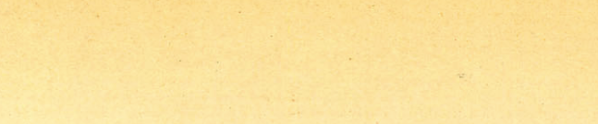
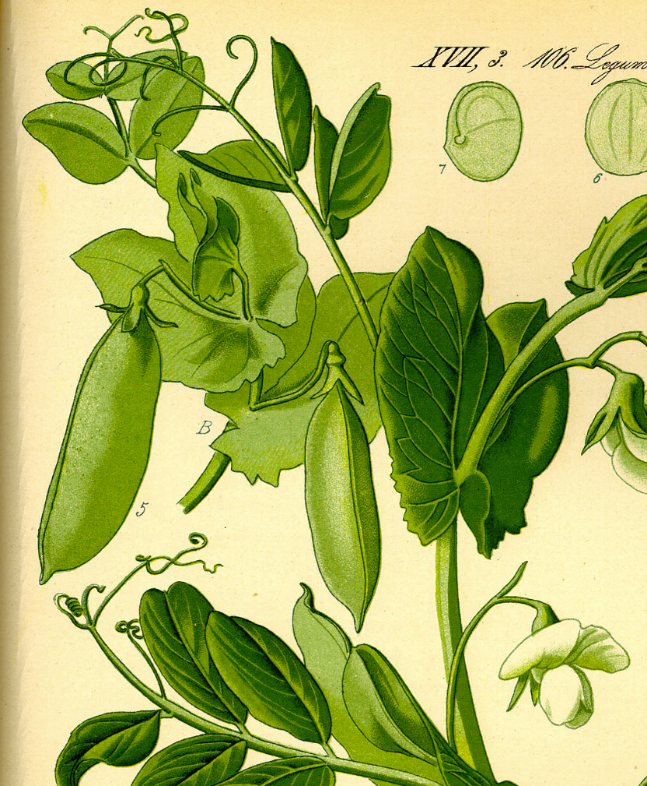

Application of Quantitative Genetics Algebra in case of one cross of Line Breeding (p=q=0.5). Species such as Wheat, Rice, Pea, many others.
We employ estimates of pertinent population parameters; here inspired by DOI 10.1111/j.1439-0523.2008.01564.x.
Take it as grain yield in [dt/ha]; E=Environment; R=Replicate=1; E=3 for F2-derived F4-families and DH-lines.
Parameter | Value
σ²_{A} | 10
σ²_{D} | 6
σ²_{Epistasis} | 0
σ²_{GE} | 24
σ²_{GER} | 12
σ²_{Indiv.(error)} | 200
Type of line / family | Available σ²_{G} | Available Add.V. | Masking σ²_{M} | h²
Betw. F2-derived F4-fam. | 10.375 | 10 | 12.01 | 0.445
Betw. F3-derived F4-lines | 16.125 | 15 | 37.0 | 0.282
Betw. F4-plants in F4-lines | 4 | 2.5 | 236.0 | 0.010
Betw. F2-individuals | 16 | 10 | 236.0 | 0.040
Betw. DH-individuals | 20 | 20 | 236.0 | 0.078
Between DH-lines | 20 | 20 | 12.01 | 0.623
Between all F2-derived F4-families, σ²_{G} ≈ σ²_{A} =10. The masking variance is 24/3 + 12/3 + 200/2000 (assume 2000 plants per plot). Hence, h² = 0.445; not too bad. It is only h²=0.282 between all F3-derived F4-lines*, assuming only E=1 and 200 plants in that one plot per entry. 0.282 < 0.455, although between these F4-lines we see 1.5-fold σ²_{A} compared to F4-families. Which gain is higher? *consider all F4-lines of our cross, as taken from all F3-plants; not only the F4-lines from plants of one F3-line!
15
Pea, https://commons.wikimedia.org/wiki/File:Illustration_Pisum_sativum0.jpg, public domain

Slide 16
16
Application of Quantitative Genetics Algebra in case of Line Breeding.
We employ estimates of pertinent population parameters; here inspired by DOI 10.1111/j.1439-0523.2008.01564.x.
Take it as grain yield in [dt/ha]; E=Environment; R=Replicate=1; E=3 for F2-derived F4-families and DH-lines.
Parameter | Value
σ²_{A} | 10
σ²_{D} | 6
σ²_{Epistasis} | 0
σ²_{GE} | 24
σ²_{GER} | 12
σ²_{Indiv.(error)} | 200
Type of line / family | Available σ²_{G} | Available Add.V. | Masking σ²_{M} | h²
Betw. F2-derived F4-fam. | 10.375 | 10 | 12.01 | 0.445
Betw. F3-derived F4-lines | 16.125 | 15 | 37.0 | 0.282
Betw. F4-plants in F4-lines | 4 | 2.5 | 236.0 | 0.010
Betw. F2-individuals | 16 | 10 | 236.0 | 0.040
Betw. DH-individuals | 20 | 20 | 236.0 | 0.078
Between DH-lines | 20 | 20 | 12.01 | 0.623
Between F2-individuals, σ²_{G} =16; σ²_{A}=10 will be inherited into the F2-derived partial bulks at homozygosity – which are the entries in this selection step (σ²_{D}=6 will vanish; σ²_{A}=10 will de novo segregate until then but is un-used, un-available, in this moment as we select between F2-individuals). The masking variance is σ²_{M}= σ²_{GE}+σ²_{GER} + σ²_{Ind.(error)} = 236. Hence, h² = 10 / (16 + 236) = 0.040.
Between DH-individuals, we have σ²_{G} = 2σ²_{A}=20 (max. Add. Variance that can segregate from that cross). Masking variance σ²_{M}= σ²_{GE}+σ²_{GER} + σ²_{Ind.(error)} = 236 like above (well, assume the DH-plants behave - as to assessment error and reaction to small-scale and large-scale environmental impact - like F2-plants); => h² = 20 / (16 + 236) = 0.078.

Slide 17
Application of Quantitative Genetics Algebra in case of Line Breeding.
17
Oats, ©Wikipedia, open source.
Einkorn, ©Wikipedia open s.
Parameter | Value
σ²_{A} | 10
σ²_{D} | 6
σ²_{Epistasis} | 0
σ²_{GE} | 24
σ²_{GER} | 12
σ²_{Indiv.(error)} | 200
Type of line / family | Available σ²_{G} | Available Add.V. | Masking σ²_{M} | h²
Betw. F2-derived F4-fam. | 10.375 | 10 | 12.01 | 0.445
Betw. F3-derived F4-lines | 16.125 | 15 | 37.0 | 0.282
Betw. F4-plants in F4-lines | 4 | 2.5 | 236.0 | 0.010
Betw. F2-individuals | 16 | 10 | 236.0 | 0.040
Betw. DH-individuals | 20 | 20 | 236.0 | 0.078
Between DH-lines | 20 | 20 | 12.01 | 0.623
Between DH-lines, we have σ²_{G} = 2σ²_{A}=20 just as between the DH individuals from which they came. The masking variance is (with E=3; R=1; N=2000 plants per field plot) much lower: σ²_{M} = (σ²_{GE} + σ²_{GER})/3 + σ²_{Plot-error} =
σ²_{M} = 24/3 + 12/3 + 200/2000 = 12.01; Hence, h² = 20 / (32.01) = 0.623. This is much higher than the h² = 0.078 of the DH individuals: So, probably nobody is yield-testing the DH generations via individuals but only via lines, i.e., in decent, replicated field plots! ... even if that means to invest in one step of extra seed multiplication and more time.

Slide 18
Example: Selection α=1%, hence i=2.665. Predicted Gain from Selection.
18
*Predicted Gain from Selection (‚Breeders‘ Equation‘) ► G = i ∙ h ∙ σ_{A} ►UNPLAB-h²_GxE_Ch-5[BreedersEquation]
Parameter | Value
σ²_{A} | 10
σ²_{D} | 6
σ²_{Epistasis} | 0
σ²_{GE} | 24
σ²_{GER} | 12
σ²_{Indiv.(error)} | 200
Type of line / family | Available Add.V. | √(h²) | Gain*
Betw. F2-derived F4-fam. | 10 | 0.667 | 5.62
Betw. F3-derived F4-lines | 15 | 0.531 | 5.48
Betw. F4-plants in F4-lines | 4 | 0.102 | 0.43
Betw. F2-individuals | 10 | 0.199 | 1.68
Betw. DH-individuals | 20 | 0.280 | 3.33
Between DH-lines | 20 | 0.789 | 9.41
Gain is slightly higher between F4-families than between F4-lines, although the useful genetic variance between F4-lines is 1.5∙σ²_{A} compared to only 1∙σ²_{A} between F4-families. Of course, when selecting between F4-families, the within-family-between-lines’ variance is not exploited. Yet. Heritability is higher between families, because they are (assumed to be) tested across E=3 environments. Joining seed of all F4-lines per family allows larger plots (2000 plants per plot), compared to only E=1 and only 200 plants per plot for single F3-lines (we neglect that e.g. σ²_{GE} for F4-families is even smaller than for F4-lines: Because of buffering effects among the different F4-lines that make one F4-family).
Gain is higher between DH-individuals than between F2-individuals, because (1) there is masking genetic variance in F2 (some σ²_{D}) that is not realized as genetic differences between the later emerging, ultimate candidate cultivars, and no such masking variance disturbs selection in DH; reason (2) is anyway known to you ;-)

Slide 19
Anything speaking against selection between DH-lines?
We employ estimates of pertinent population parameters to predict gain from selection ► G = i ∙ h ∙ σ_{A}
Parameter | Value
σ²_{A} | 10
σ²_{D} | 6
σ²_{Epistasis} | 0
σ²_{GE} | 24
σ²_{GER} | 12
σ²_{Indiv.(error)} | 200
Type of line / family | Available Add. V. | h² | Gain*
Betw. F2-derived F4-fam. | 10 | 0.445 | 5.62
Betw. F3-derived F4-lines | 15 | 0.282 | 5.48
Within F4-lines | 4 | 0.010 | 0.42
Betw. F2-individuals | 10 | 0.040 | 1.69
Betw. DH-individuals | 20 | 0.078 | 3.33
Between DH-lines | 20 | 0.623 | 9.41
Gain is maximum between DH-lines. We have maximum genetic variance, no masking genetic variance, With E=3 and decently large plots, we have high h².  Any argument speaking against DH-lines?
 Of course, if the species does not allow DH production (e.g. Vicia faba, faba bean; recalcitrant species).
 If during DH-production (via petri dish; via inducer …), if there was un-intended selection that might impair gain in the agronomic traits: That could speak against. Probably this is rarely a problem.
 If we need more than one meiosis (the one from F1 to its DH-establishing gametes) to dissolve unfortunate parental allele-phases, i.e. to realize novel recombined genotypes and useful transgression. Then, selecting between RILs might be better than between DHs (or even decent pre-breeding may be needed; Link und Becker, 2010, 77-80;
http://www.saatgut-austria.at/MEDIA/2009_Tagungsband.pdf).
19

Slide 20
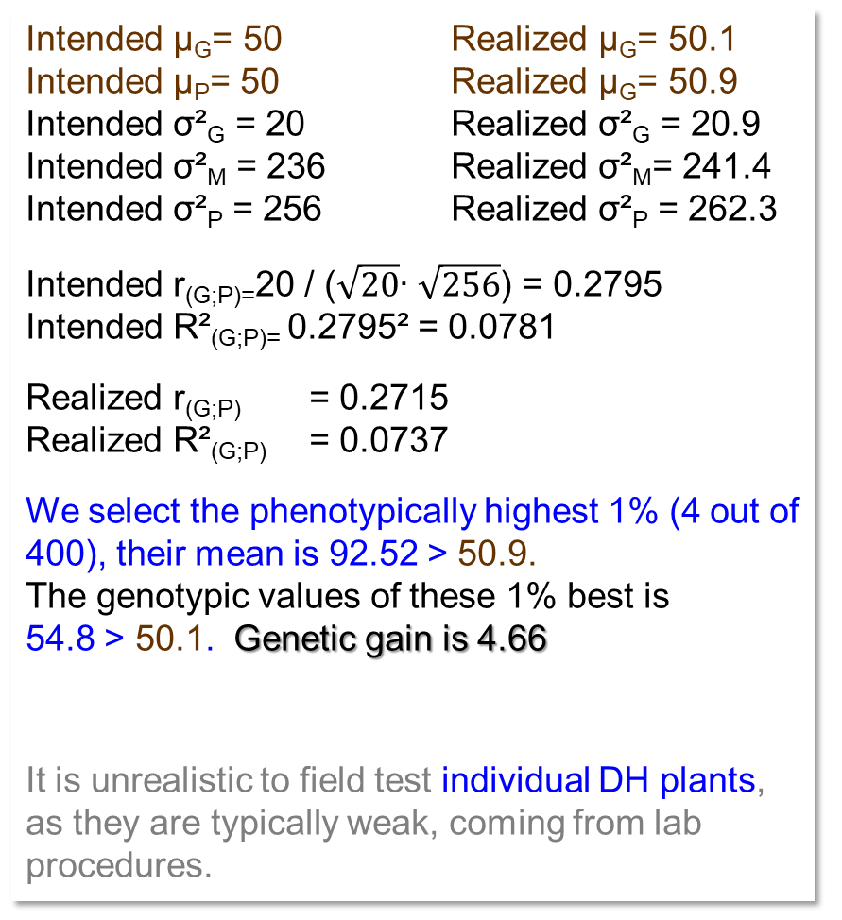
Simulated data to visualize variance, covariance and gain from phenotypic selection among DH individuals. Parameters in simulation differ slightly from ideal ones.
100
90
Intended µ_{G}= 50 Realized µ_{G}= 50.1
Intended µ_{P}= 50 Realized µ_{G}= 50.9
Intended σ²_{G} = 20 Realized σ²_{G} = 20.9
Intended σ²_{M} = 236 Realized σ²_{M}= 241.4
Intended σ²_{P} = 256 Realized σ²_{P} = 262.3
Intended r_{(G;P)=}20 / ($\sqrt{20}$∙ $\sqrt{256}$) = 0.2795
Intended R²_{(G;P)=} 0.2795² = 0.0781
Realized r_{(G;P)} = 0.2715
Realized R²_{(G;P)} = 0.0737
We select the phenotypically highest 1% (4 out of 400), their mean is 92.52 > 50.9.
The genotypic values of these 1% best is
54.8 > 50.1. Genetic gain is 4.66
It is unrealistic to field test individual DH plants, as they are typically weak, coming from lab procedures.
80
70
60
54.8
Genotypic values DHs
50
40
30
20
10
92.52
0
0
10
20
30
40
50
60
70
80
90
100
20
Phenotypic values DH individuals

Slide 21
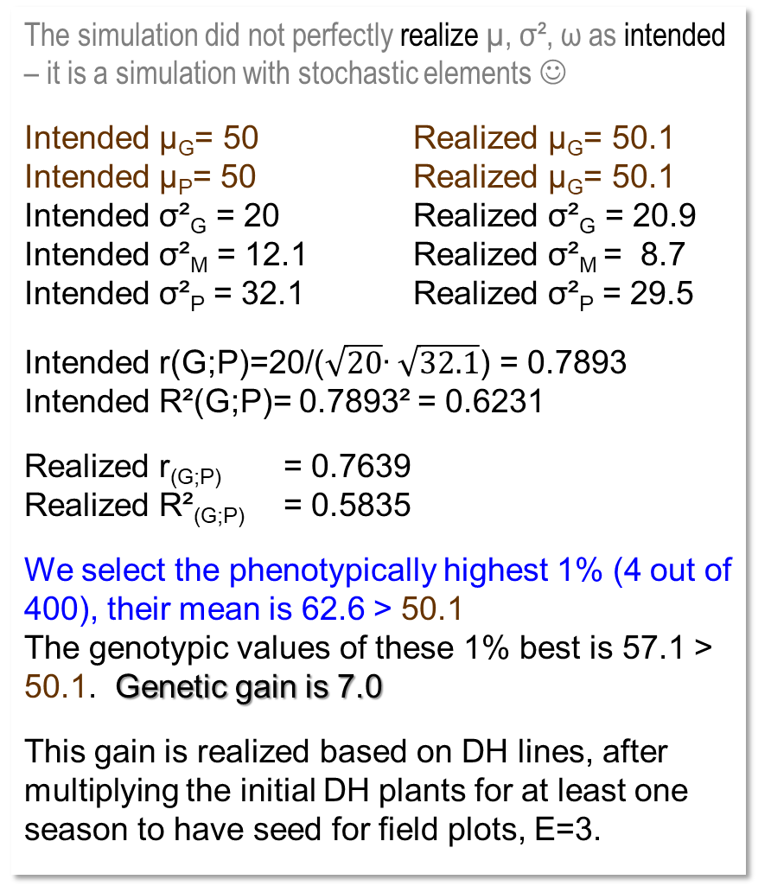
Simulated data … gain from phenotypic selection among DH lines (E=3; R=1)
70
The simulation did not perfectly realize µ, σ², ω as intended – it is a simulation with stochastic elements ☺
Intended µ_{G}= 50 Realized µ_{G}= 50.1
Intended µ_{P}= 50 Realized µ_{G}= 50.1
Intended σ²_{G} = 20 Realized σ²_{G} = 20.9
Intended σ²_{M} = 12.1 Realized σ²_{M} = 8.7
Intended σ²_{P} = 32.1 Realized σ²_{P} = 29.5
Intended r(G;P)=20/($\sqrt{20}$∙ $\sqrt{32.1}$) = 0.7893
Intended R²(G;P)= 0.7893² = 0.6231
Realized r_{(G;P)} = 0.7639
Realized R²_{(G;P)} = 0.5835
We select the phenotypically highest 1% (4 out of 400), their mean is 62.6 > 50.1
The genotypic values of these 1% best is 57.1 > 50.1. Genetic gain is 7.0
This gain is realized based on DH lines, after multiplying the initial DH plants for at least one season to have seed for field plots, E=3.
60
Genotypic values DHs
50
40
30
30
40
50
60
70
Phenotypic values DH lines
21

Slide 22
Take home:
Multi-locus segregation causes new genotypic diversity in each selfing generation. Nevertheless, size of fresh segregation variance is proportionally to the degree of that heterozygosity that caused it. Due to this, the additional increment in variance can typically be neglected as early as (about) F₆ generation.
The additive share of the genetic variance in the basic generation F₂ remains (in case of no selection) across the selfing generations. Further generations of selfing release further additive variance. These bits of additive variance add up, until F∞, to twice the additive variance in F2. In later generations of selfing, the breeder thus has a markedly greater amount of additive variance than in the early generations of selfing.
That part of the genetic variance that is caused by dominance effects decreases from generation to generation. Already at about F₄ we can usually neglect dominance as cause of genetic variance.
22

Slide 23
So far we have had the perspective of one cross, i.e. one pair of parents and their offspring in generations F1, F2 to F∞. We looked from the crossing to the array of all possible inbred lines – DHs or RILs - that can be developed from such cross.
We have barely considered the difference between the crosses for the variance between the RILs of each of these crosses.
Some pairs of parents may lead to a high segregation, hence, to a high amount of diversity to select from. Other pairs of parents may lead to a smaller variance from segregation, hence, the resources to select and realize improvement due to selection would be smaller in such crosses.
23

Slide 24
We should expect that (1) the more the parents are genetically different (for the genes of the trait) the more (2) their F1 will be heterozyous, the more (3) loci in F1 will segre-gate, and (4) the more variance will emerge between the ultimate RILs of that cross.
Parental inbred line 1
Distance Distance
Parental inbred line 2
[ AA/BB/CC/DD/ee]
Different alleles, parents largely complement each other
[aa/bb/bb/cc/ee]
Mendelian F1 hybrid
Heterozygosity: Potency to segregate; Variance on hold, in wait-and-see mode; Reserve potential for variability.
[ Aa/Bb/Cc/Dd/ee ]
24
The parental pair could as well have been e.g. [αα/BB/bb/cc/ee] and [αα/bb/CC/DD/EE] … et cetera.

Slide 25
We should expect that (1) the more the parents are genetically different (for the genes of a trait), (2) the more their F1 will be heterozyous, (3) the more loci in F1 will segre-gate, and (4) the more variance will emerge between the ultimate RILs of that cross.
Parental inbred line 1
Distance Distance
Parental inbred line 2
[ AA/BB/CC/DD/ee]
Different alleles, parents largely complement each other
[aa/bb/bb/cc/ee]
Mendelian F1 hybrid
Heterozygosity: Potency to segregate; Variance on hold, in wait-and-see mode; Reserve potential for variability.
[ Aa/Bb/Cc/Dd/ee ]
Mendelian F∞ generation (aka RIL); not all recombined lines are shown here
[AA/BB/CC/DD/ee] [AA/BB/CC/dd/ee] [AA/BB/cc/DD/ee] [aa/bb/CC/DD/ee] [aa/BB/cc/DD/ee] [aa/bb/cc/DD/ee] [aa/bb/cc/dd/ee]
[AA/BB/CC/DD/..] [aa/BB/CC/DD/ee] [AA/bb/CC/DD/ee] [AA/BB/cc/dd/ee] [aa/BB/cc/dd/ee] [AA/bb/cc/dd/ee] [aa/bb/cc/dd/..
… … … … ...]
Genetic variance in Generation F∞: Realized segregation! Heterozygosity of F1, as ‘set free’, becomes Variance.
25
The parental pair could as well have been e.g. [αα/BB/bb/cc/ee] and [αα/bb/CC/DD/EE] … et cetera.

Slide 26
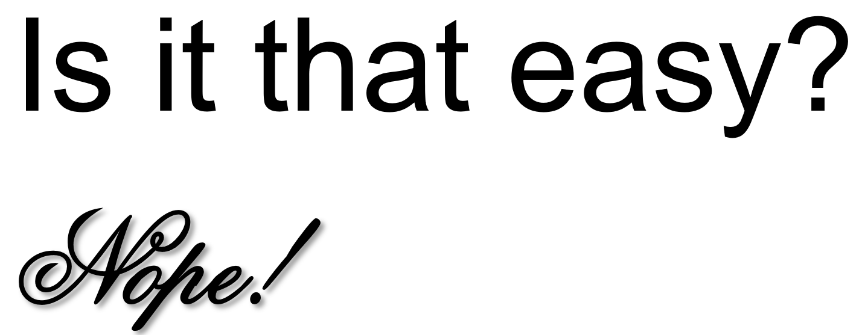
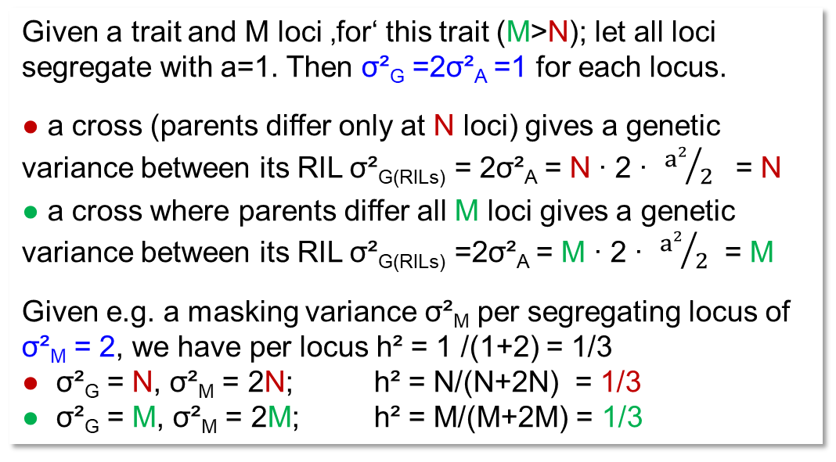
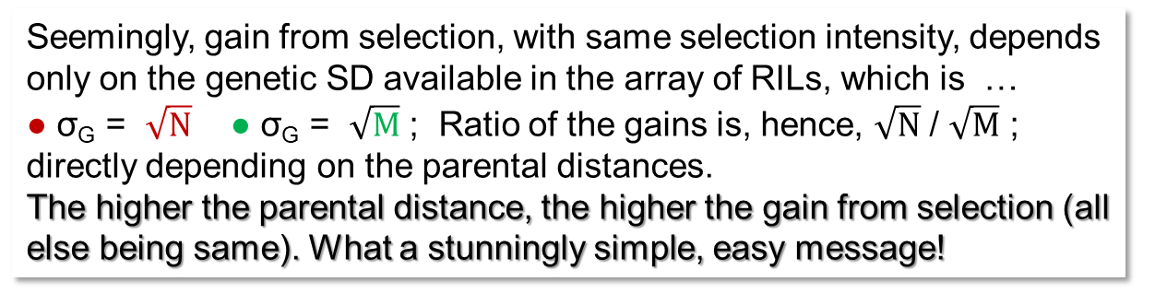
We should expect that (1) the more the parents are genetically different (for the genes of a trait), (2) the more their F1 will be heterozyous, (3) the more loci in F1 will segre-gate, and (4) the more variance will emerge between the ultimate RILs of that cross.
Parental inbred line 1
Given a trait and M loci ‚for‘ this trait (M>N); let all loci segregate with a=1. Then σ²_{G} =2σ²_{A} =1 for each locus.
● a cross (parents differ only at N loci) gives a genetic variance between its RIL σ²_{G(RILs)} = 2σ²_{A} = N ∙ 2 ∙ ${a²}/2$= N
● a cross where parents differ all M loci gives a genetic variance between its RIL σ²_{G(RILs)} =2σ²_{A} = M ∙ 2 ∙ ${a²}/2$ = M
Given e.g. a masking variance σ²_{M} per segregating locus of σ²_{M} = 2, we have per locus h² = 1 /(1+2) = 1/3
● σ²_{G} = N, σ²_{M} = 2N; h² = N/(N+2N) = 1/3
● σ²_{G} = M, σ²_{M} = 2M; h² = M/(M+2M) = 1/3
Parental inbred line 2
Different at N or
M loci
Mendelian F1
hybrid
Heterozygous at N or M loci
Mendelian F∞
generation (aka RIL)
Segregates at N or
M loci
Mendelian F∞
generation (aka RIL)
2σ²_{A} from N or
M loci
26
Seemingly, gain from selection, with same selection intensity, depends only on the genetic SD available in the array of RILs, which is …
● σ_{G} = $\sqrt{N}$ ● σ_{G} = $\sqrt{M}$ ; Ratio of the gains is, hence, $\sqrt{N}$ / $\sqrt{M}$ ;
directly depending on the parental distances.
The higher the parental distance, the higher the gain from selection (all else being same). What a stunningly simple, easy message!

Slide 27
These are some important publications, dealing with the relationship between parental genetic distance (difference) and the size of the to-be-expected genetic variance from their Mendelian cross-offspring (F2, DH-lines, RILs).
Tobias A M Niehoff, Jan ten Napel, Mario P L Calus, 2024: Prediction of additive genetic variances of descendants for complex families based on Mendelian sampling variances, G3 Genes|Genomes|Genetics. jkae205, https://doi.org/10.1093/g3journal/jkae205.
Christina Lehermeier, Simon Teyssèdre, Chris-Carolin Schön, 2017: Genetic Gain Increases by Applying the Usefulness Criterion with Improved Variance Prediction in Selection of Crosses. Genetics, 207, 4, Pages 1651–1661. https://doi.org/10.1534/genetics.117.300403.
Osthushenrich T, Frisch M, Herzog E, 2017: Genomic selection of crossing partners on basis of the expected mean and variance of their derived lines. PLOS ONE 12(12): e0188839. https://doi.org/10.1371/journal.pone.0188839
Gumber, R., Schill, B., Link, W., von Kittitz, E., Melchinger, A., 1999: Mean, genetic variance, and usefulness of selfing progenies from intra- and inter-pool crosses in faba beans (Vicia faba L.) and their prediction from parental parameters. Theor Appl Genet 98, 569–580. https://doi.org/10.1007/s001220051106.
Schnell, FW, and HF Utz, 1975: F1-Leistung und Elternwahl in der Züchtung von Selbstbefruchtern. Arbeitstagung der Arbeitsgemeinschaft der Saatzuchtleiter in Gumpenstein, November 1975, 243-247.
SDNPW-PBZ-921051416230
27

Slide 28
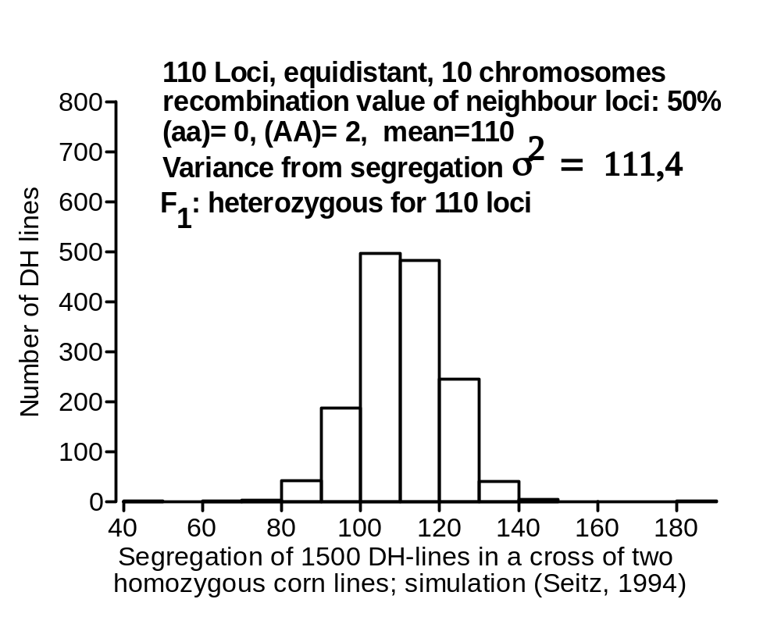
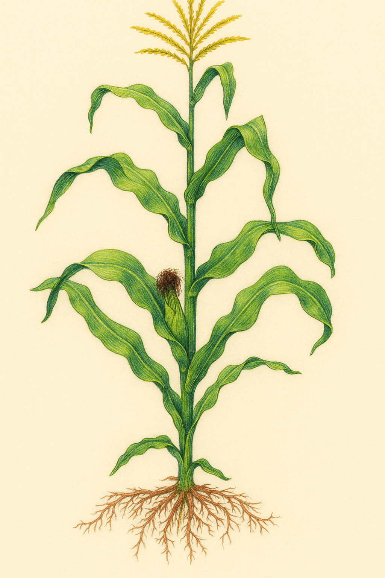
Simulation for maize (10 chromosomes of similar ‚size‘). Metric additive effect a=1.
Seitz, G., 1994, unpublished.
Theoretically, the genetic variance from these 110 loci should be 110 ∙ 1 (this simulation gave : σ²_{G}=111.4). We assume free segregation (recombination 50%).
The highest genetic value at homozygous level would be G_{max} = 110 ∙ 2 = 220 (lowest, G_{min} = 0; µ = 110 ∙ 1 = 110).
The probability to get any DH line below 80 or above 140 is nearly zero.
28

Slide 29
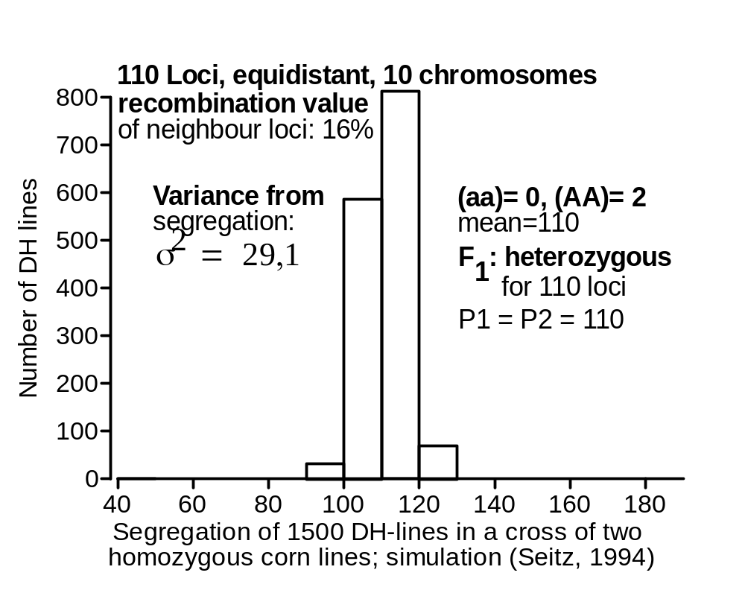
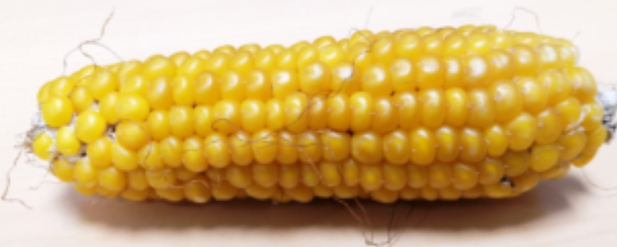
If zero linkage, then the phases of these 110 loci as given in the parents are irrelevant. Yet: If there is linkage, then the gamete phases (haplotypes) as exist in the parents are transferred more frequently than the recombined ones. Right histogram: Loci with favourable and unfavourable alleles are neighbored, 16% recombination between neigh-bored loci. Parents complement each other perfectly. See the + and – signs! The thus-resulting DH lines receive mostly one or several pairs of [+ & –] loci. They cancel each other in their joint effect on the trait ... therefore DH lines with very many + or very many – are rare (in this setting). N.B.: Trait value of parents is same.
+-+-+-+-+-+
-+-+-+-+-+-
…or…
-----------
+++++++++++
…or…
+-+-+-+-+-+
-+-+-+-+-+-
©WL
Zero linkage
Linkage > 0
29

Slide 30
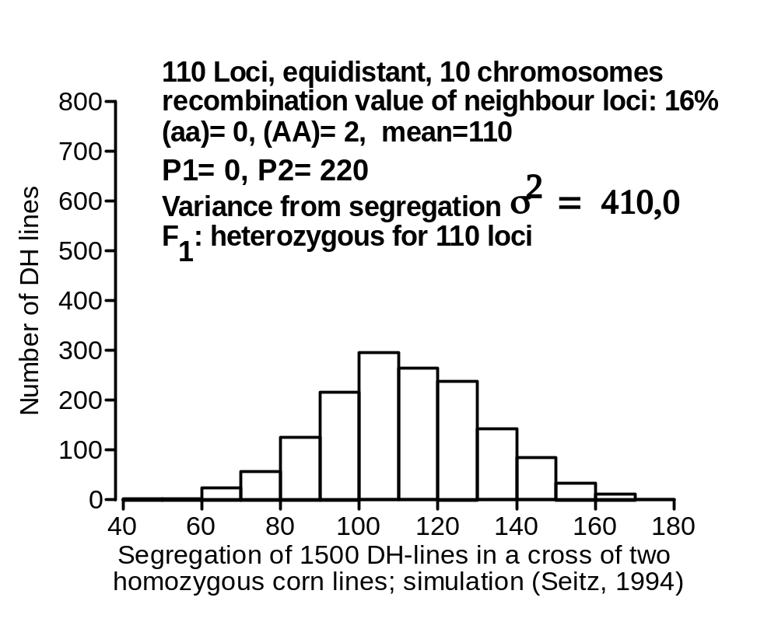
If zero linkage, then the phases of these 110 loci as given in the parents are irrelevant.
Left-side histogram is again with 16% recombination: But the parents are different. One parent now has all positive alleles + , whereas the other parent has all negative alleles - . Again, the DH lines receive mostly one or several pairs of loci as they are packed in the parents, so either [+ & +] or [- & -] genes. Now, left, very many more RILs emerge that have either many positive alleles or many negative alleles. The variance from segregation now is large.
-----------
+++++++++++
+-+-+-+-+-+
-+-+-+-+-+-
©WL
Linkage > 0
Linkage > 0
30

Slide 31
If variance from segregation can be σ²_{G} = 410 or σ²_{G} = 29, although number of hetero-zygous (segregating) loci etc. is same … then the degree of heterozygosity is not the only important factor influencing variance from segregation. This is just true. Parental phase matters. https://doi.org/10.1007/BF03195228
-----------
+++++++++++
+-+-+-+-+-+
-+-+-+-+-+-
31

Slide 32
Conclusion. Indeed, it is the level of genetic difference between the parents which ‚makes‘ the level of heterozygosity in F1. And the level of heterozygosity in F1 has major impact on its heterosis and on the amount of variance from segregation in F2 and later, until F∞. But. Even from DNA-marker estimates on parental distance, neither heterosis nor segregation variance can – usually – be well predicted (although this would help a lot). This is because – heterosis – the overly simple dominance model is not explaining heterosis in full and – variance – because linkage and parental phases and variation in effect size of genes add complexity.
32
-----------
+++++++++++
+-+-+-+-+-+
-+-+-+-+-+-

Slide 33

From here you may go to UNPLAB-QuGen_Ch-13[GenCov I]
… we are meanwhile dramatically approaching the end of the series of
UNPLB chapters ...
“A hiker in Bavarian attire climbing a high mountain, and the viewer will already see much of the exhilarating panorama that the hiker will also see after about 50 metres. With a summit cross and two friends who are already at the top and have spread out their picnic. A sign tells her: ‘Few steps left, soon on top’ “
Bavaria is a Federal State in South-East Germany.
33
33

